Slide 1
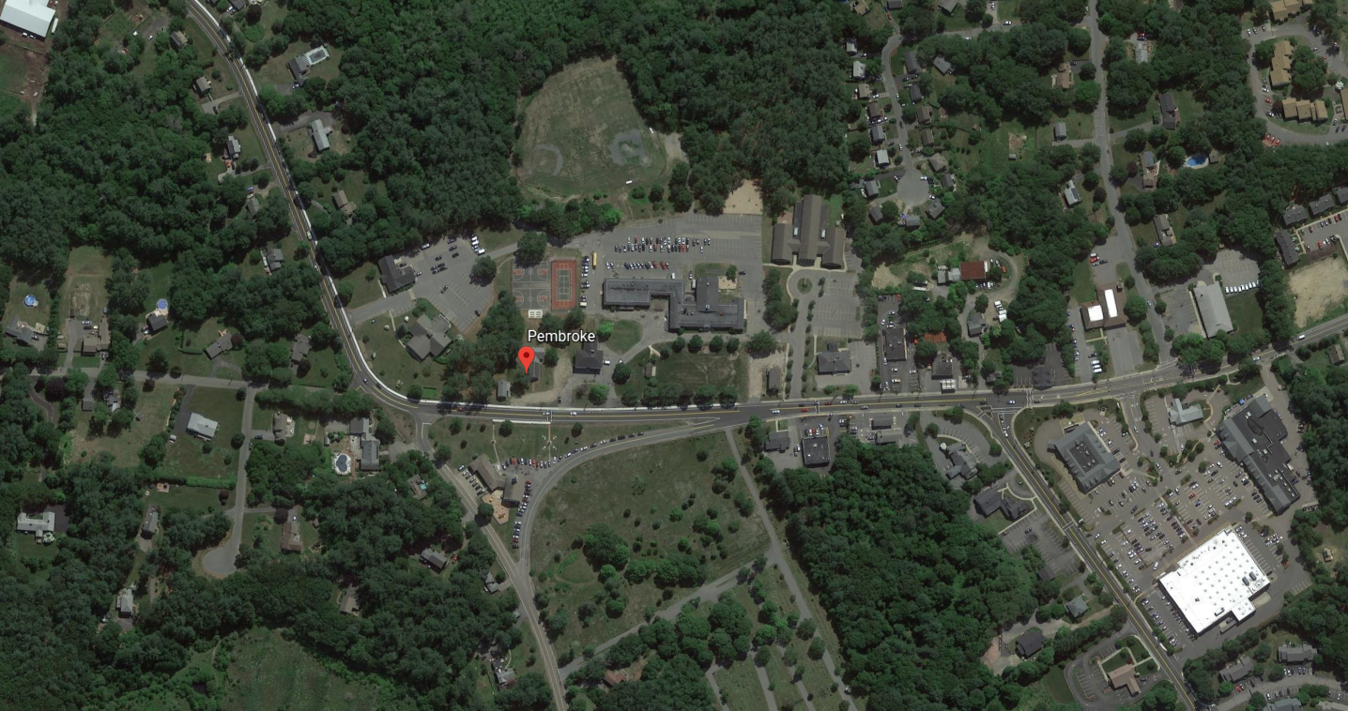
Pembroke Community Center
March 10, 2020

Slide 2
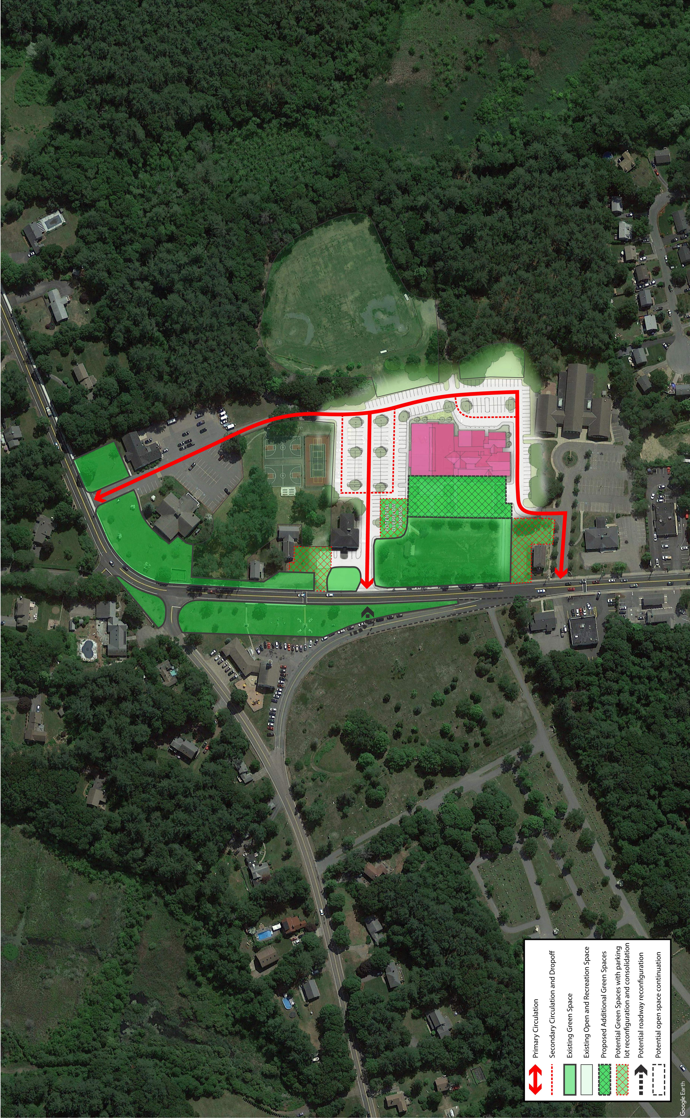
Library
Community Center
Town Hall
Site Diagram
Connecting the Town Green
& Circulation Routes
Notes:
This shows how the historic district and the open space near Town Center ties into the Community Center site, The Community Center and the Library become “anchors” to this district.
The slide also shows the vehicular ingress and egress paths. With three different access points, the Community Center site will be well served for traffic and emergency responders.

Slide 3
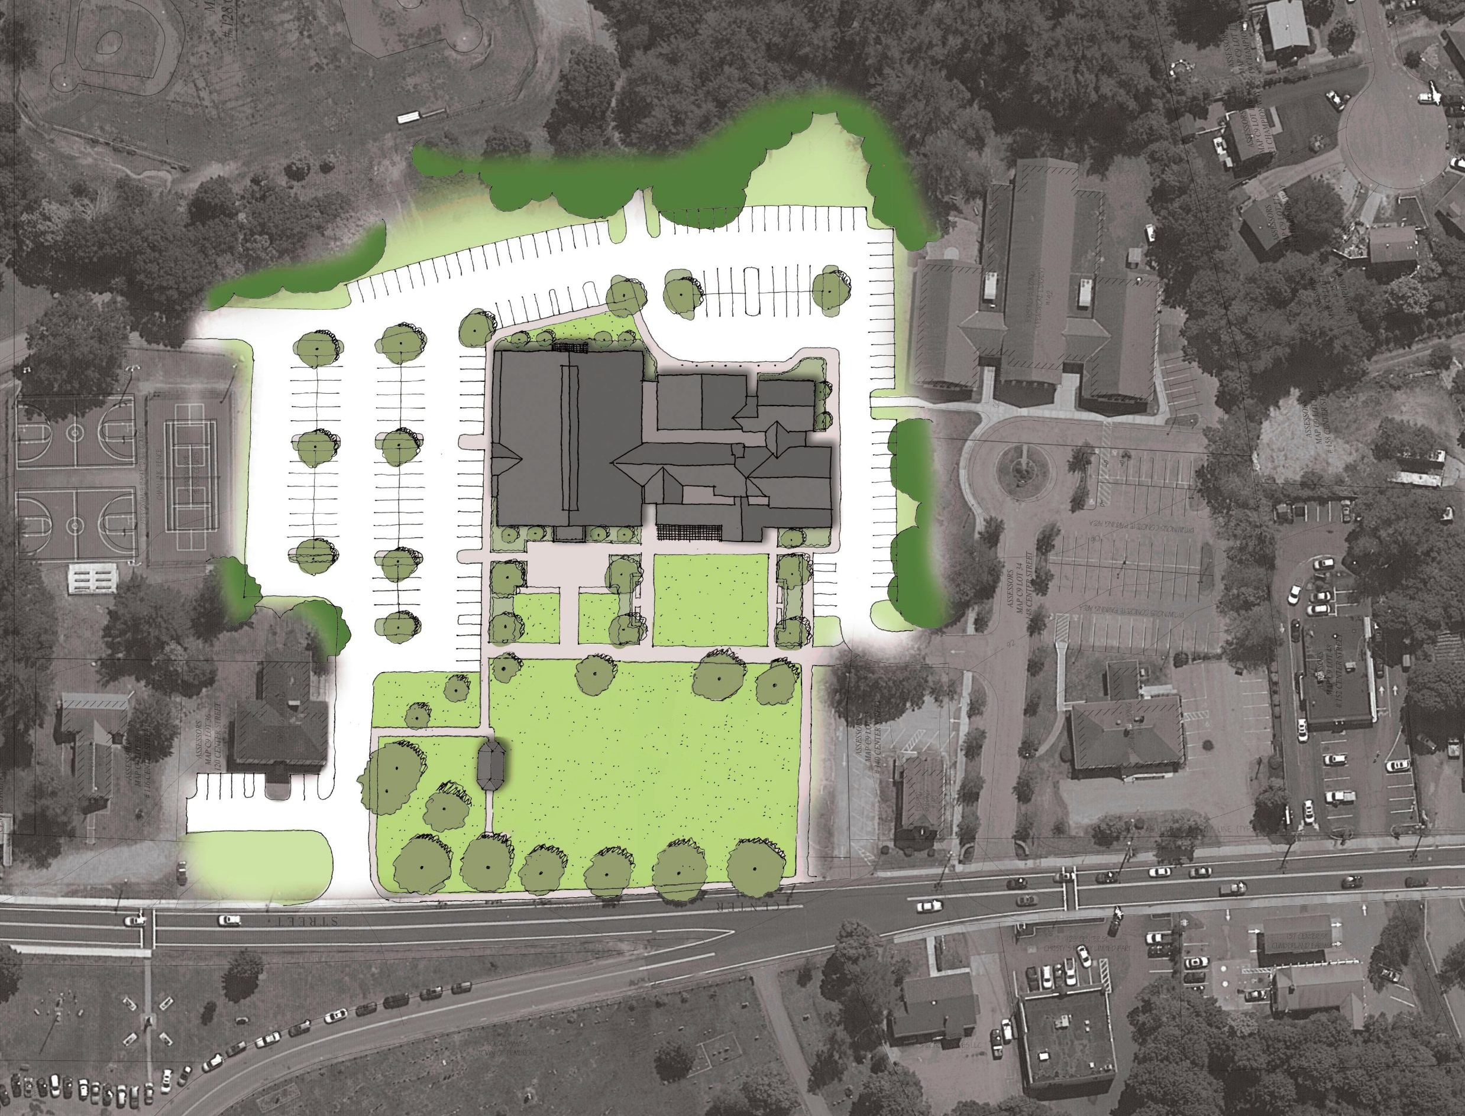
Expansion of
Town Green
Site Diagram
Notes:
Ths is an enlargement of the building, parking and open space. The Pembroke Town Green with its gazebo off of Main Street is left open and unchanged. The Green is expanded towards the Community Center building with a second “Green” space specifically located for recreation and senior outdoor activities.

Slide 4
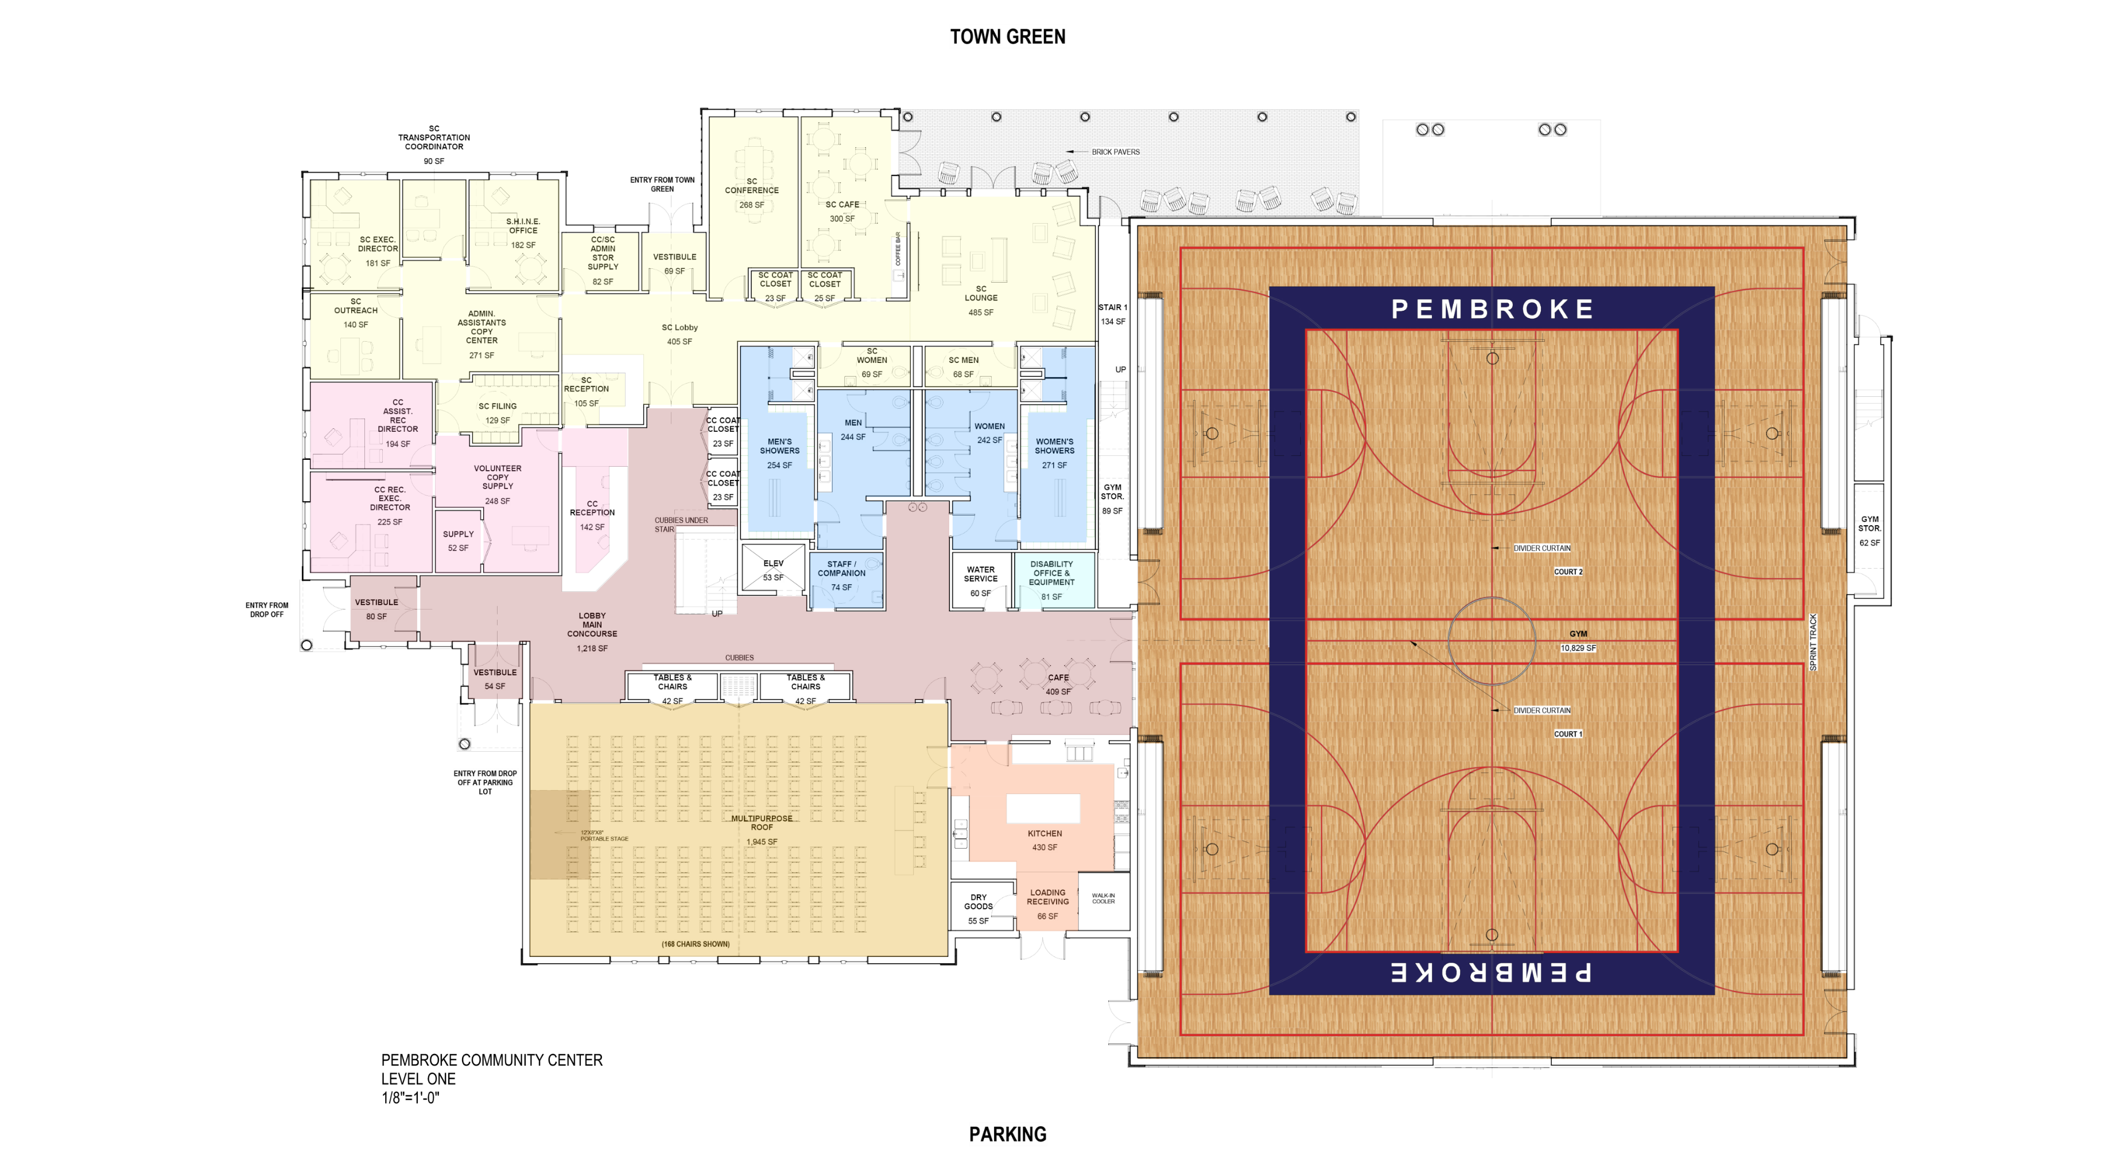
Level One
Site Diagram
22,101 GSF LEVEL ONE
11,171 GSF LEVEL TWO
33,272 GSF TOTAL
Notes:
First Floor plan showing the dedicated Senior Center spaces in light yellow. The Food Pantry is the light green rectangle. The gym is shown as a full double court based on information provided by the recreation department indicating how the afterschool program and various basketball leagues could use a double court.

Slide 5
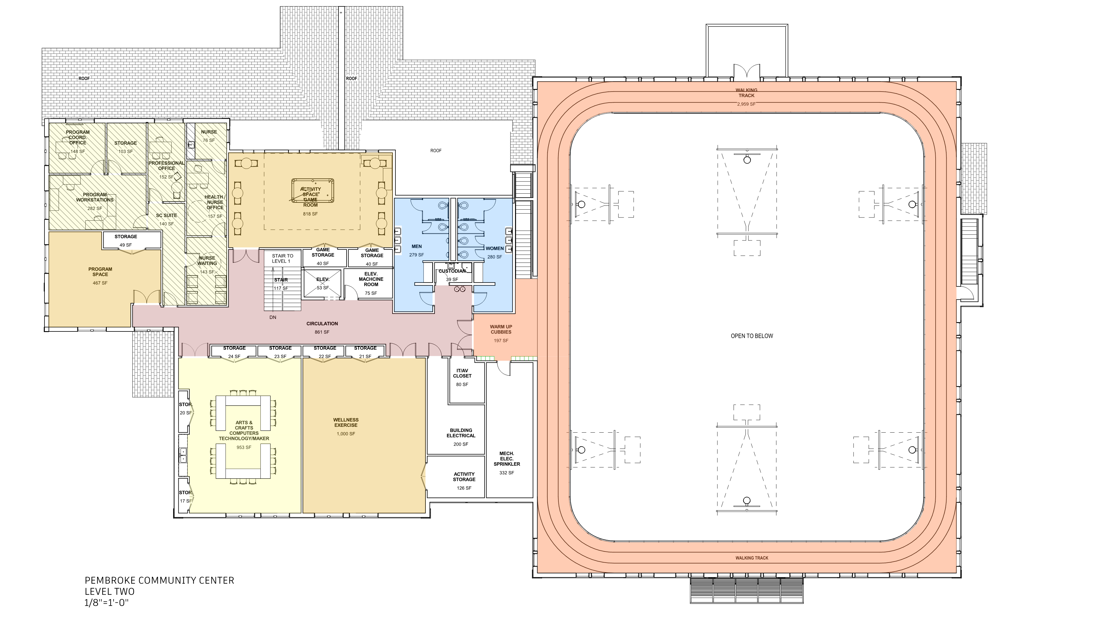
Level Two
Site Diagram
22,101 GSF LEVEL ONE
11,171 GSF LEVEL TWO
33,272 GSF TOTAL
11,171 GSF
Notes:
The second floor of the Community Center includes a walking track and various flexible program rooms. There are also some dedicated senior spaces that work best with extra privacy that is afforded by being on the upper level.

Slide 6
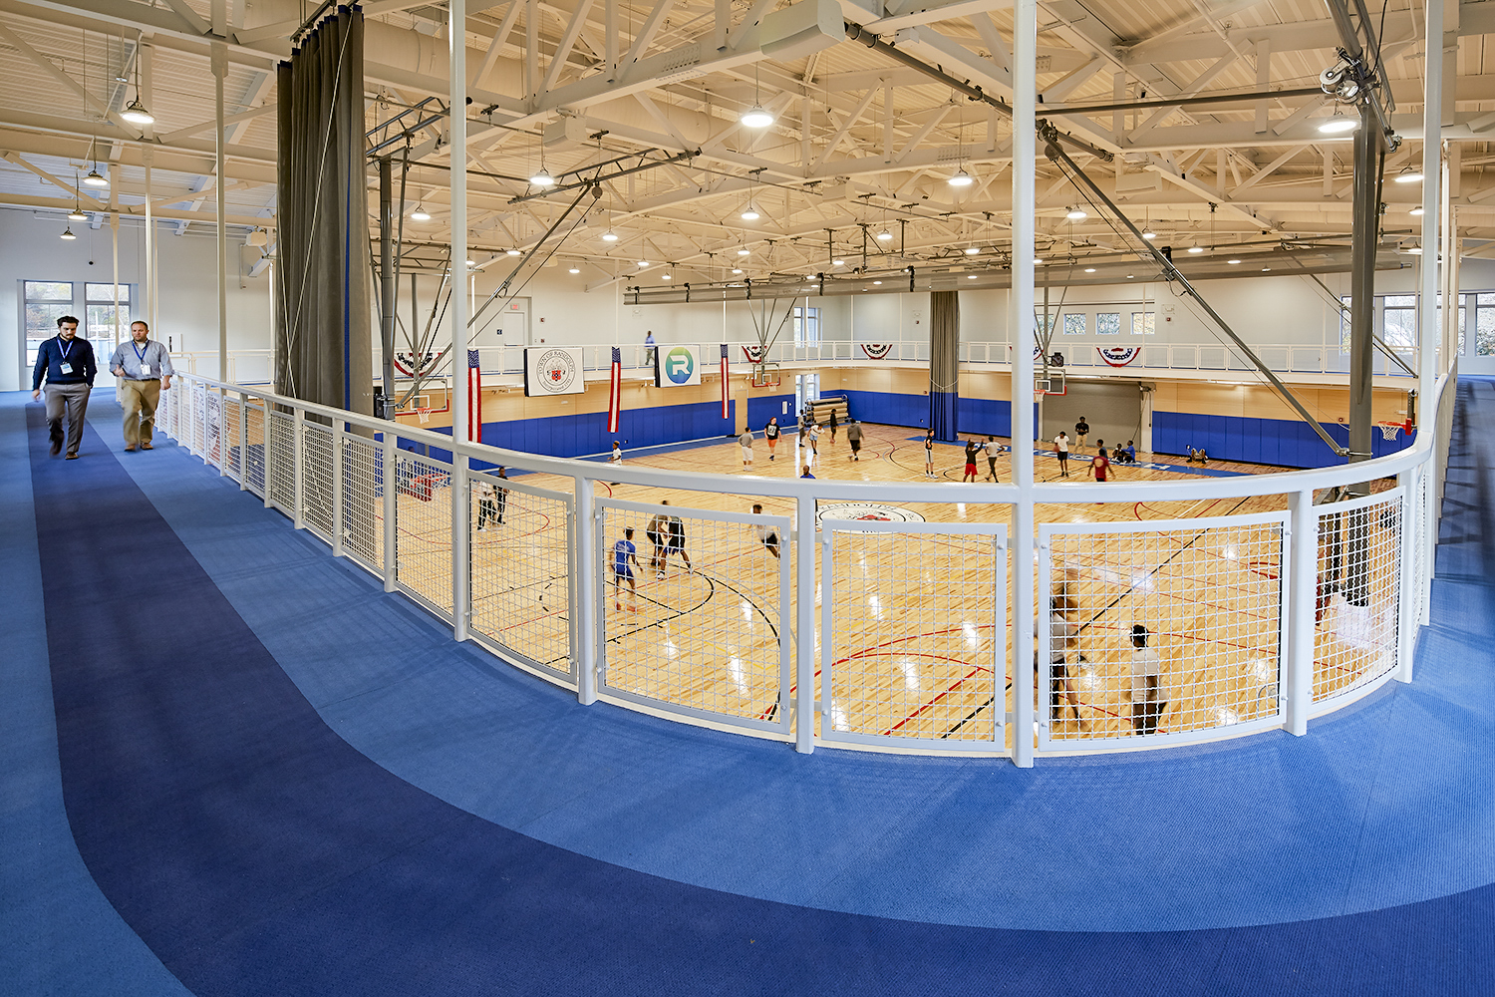
Gym & Track
Notes:
This is an example of the gym size with the walking track above.

Slide 7
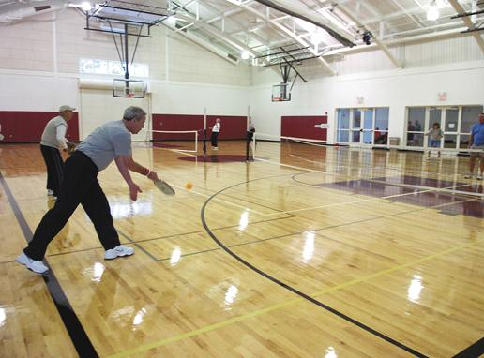
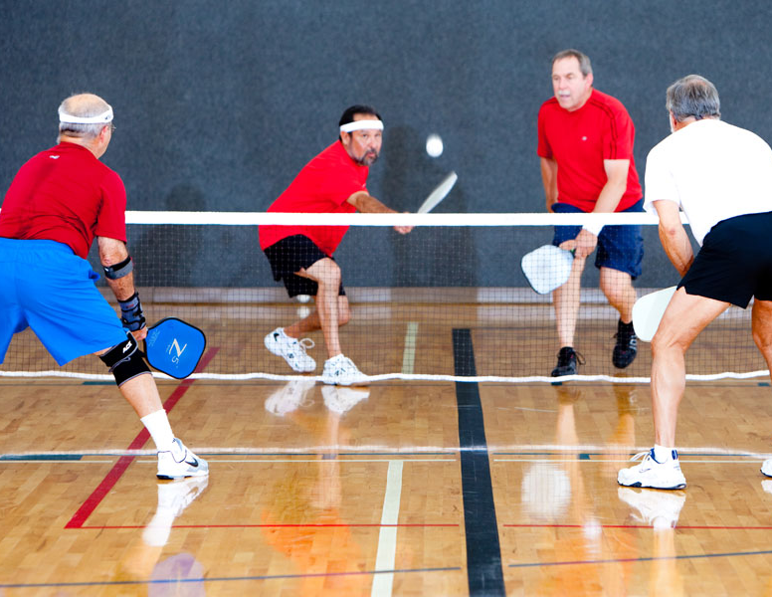
Notes:
The gym will accommodate up to 4 pickleball games at once. The nets are very easy to set up and take down meaning seniors can use these in the morning and youth afterschool with minimal effort. Pickleball is a hugely popular sport gaining in popularity with all ages, not just seniors.

Slide 8
Inside & Outside: Summer Camp Provisions
Notes:
The gym can have large doors opening on either side. One side will open to the Town Green and the other will open to the parking lot, outdoor courts and fields. The doors make it easy for summer campers to get in out of a sudden rain storm or to provide complementary indoor space to events that may take place on the green.

Slide 9
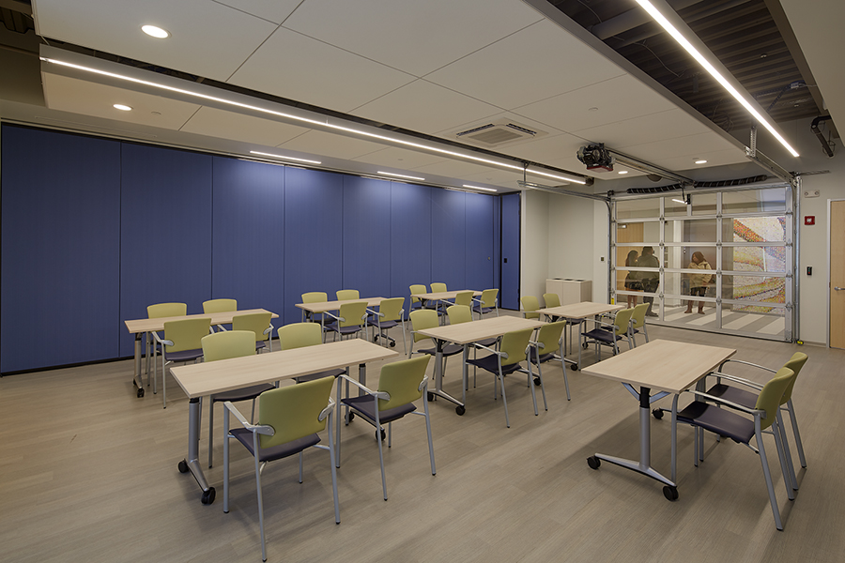
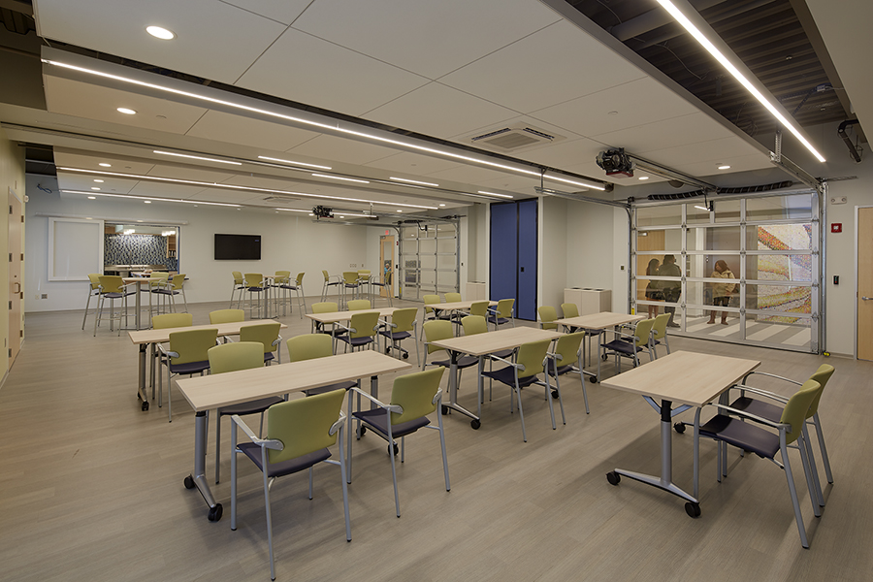
Multi-Purpose
Notes:
This is an example of the flexible sub dividable program rooms on first floor.

Slide 10
Senior Dining & Kitchen Alcove
Notes:
This is an example of the size of the Senior Congregate dining area. Larger events will be served in the multi-purpose room. The senior kitchen pantry opens up to their dining room.

Slide 11
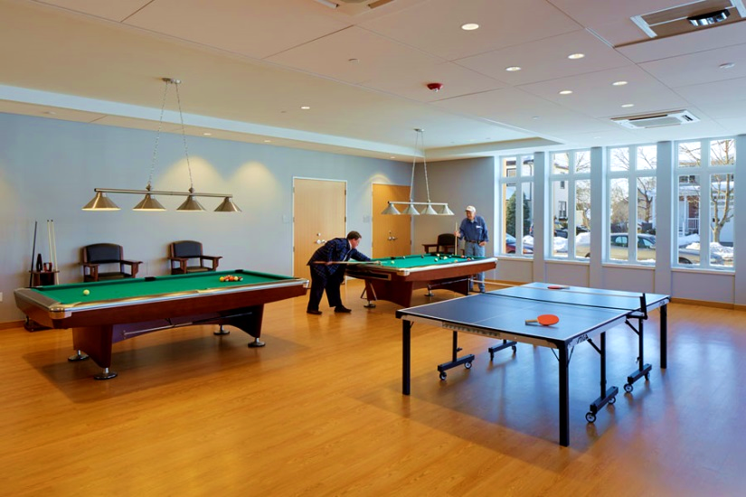
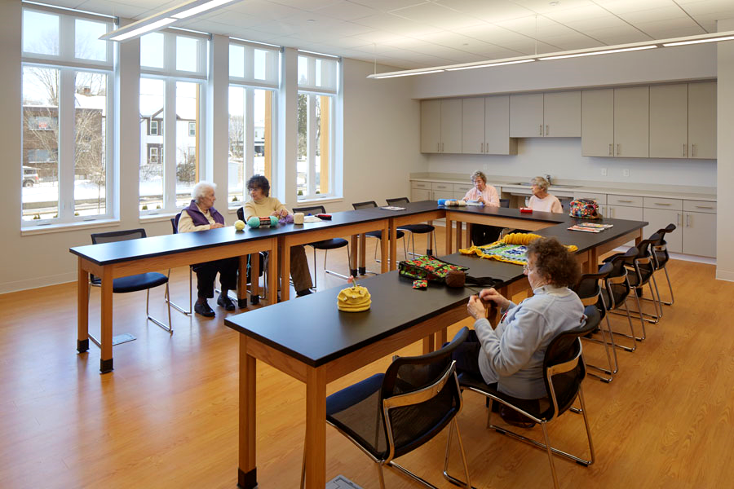
Flexible Versus Purpose-Built
Notes:
These are examples of flexible rooms (on the left) that can be converted for multiple uses. Sometimes, we design very specific purpose-built space like the above game room. It all depends on what a community wants.

Slide 12
Set Up & Take Down
Notes:
This slide shows two activities in the same room at the Nantucket Senior Center. It demonstrates why multiple program rooms are needed as Senior Center staff are not on site to set up and take down furniture all day long.

Slide 13
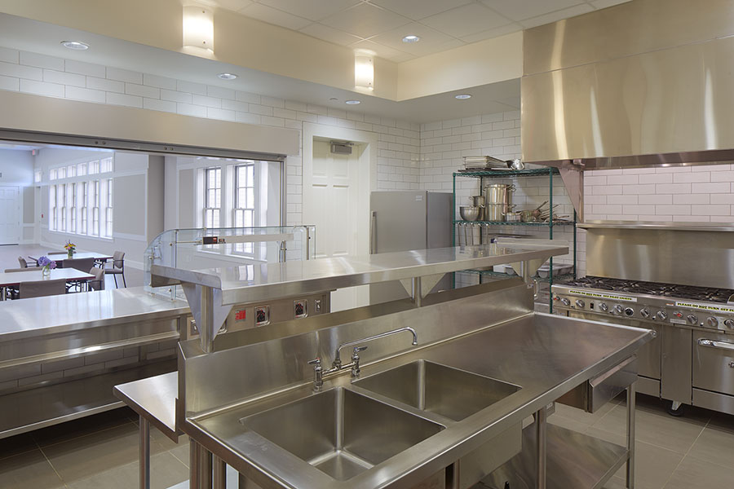
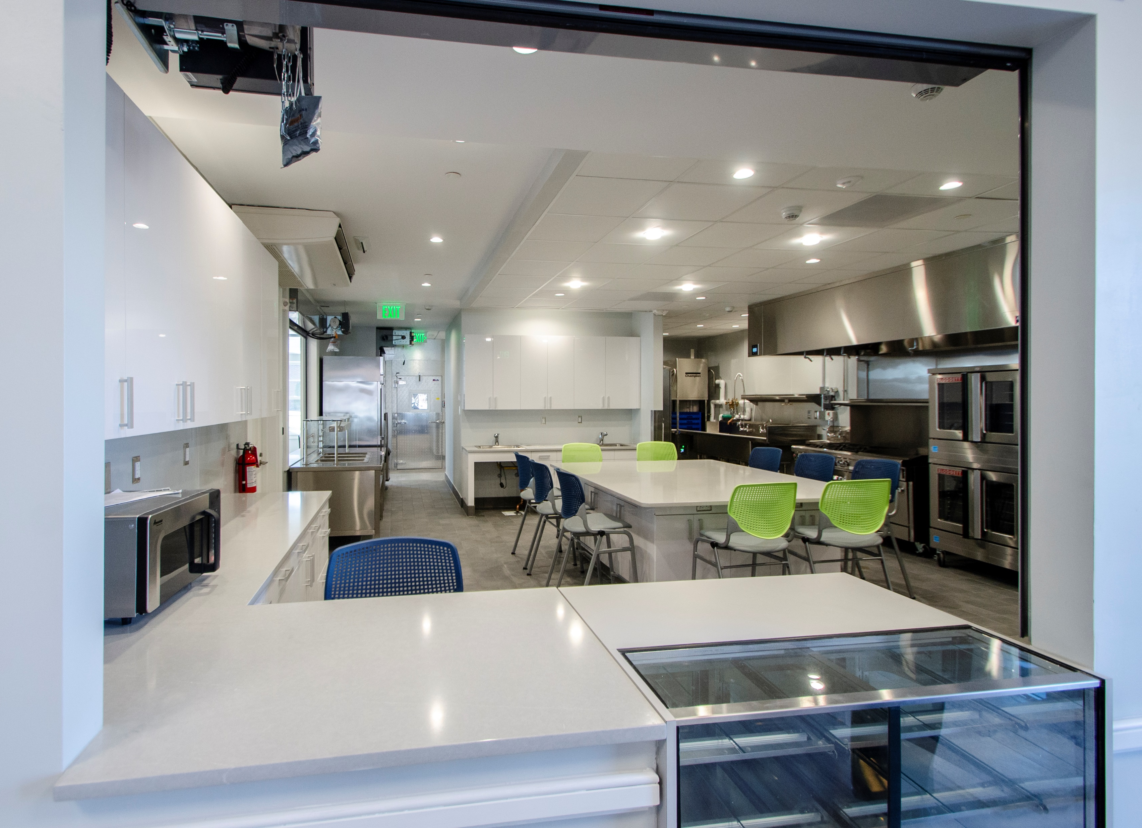
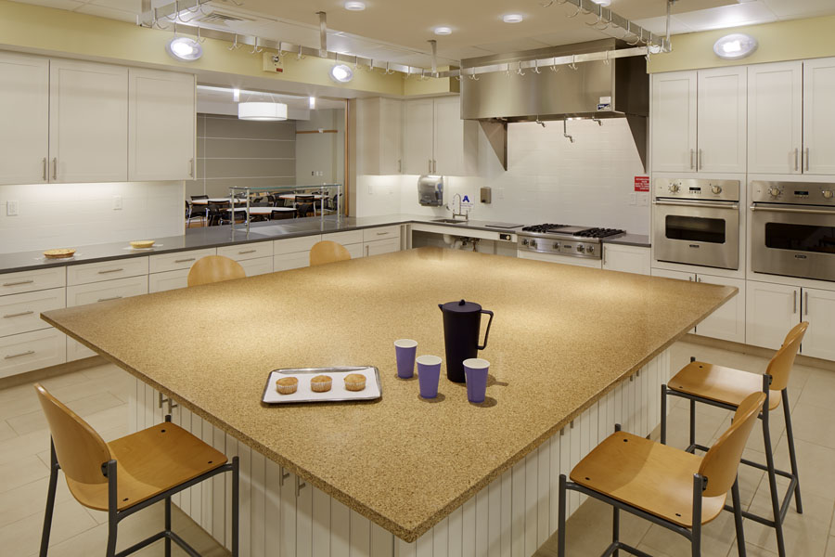
Turning Support Space into Program Space
Notes:
Both of these kitchens are health department approved but the one on the right is more user friendly and the center islands turns it into a program or activity type space for all ages.

Slide 14
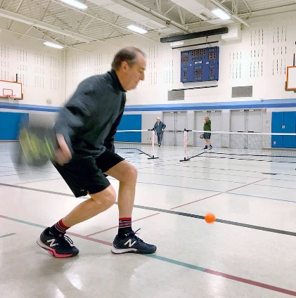
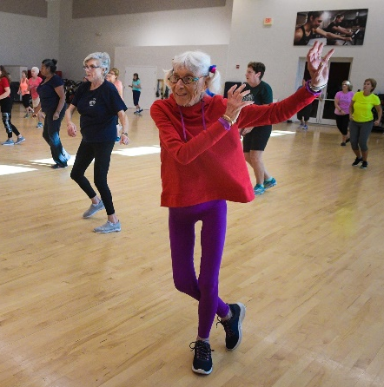
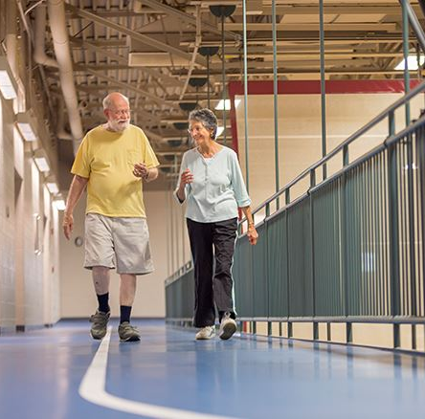
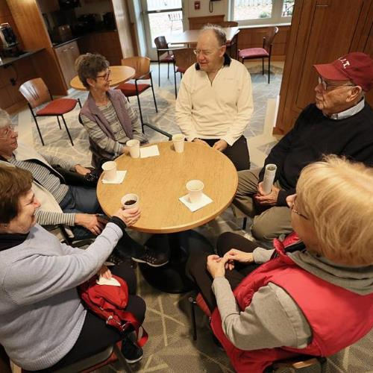
Typical Morning
Notes:
The beauty of a Senior Center with a Community Center is that the space can be shared due to the natural flow of the daily schedule. Seniors will tend to use the center in the morning and early afternoon.

Slide 15
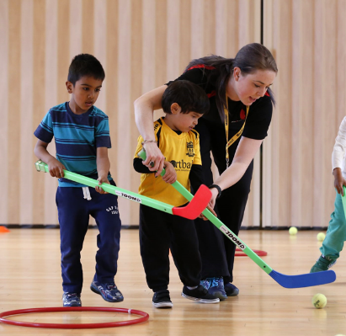
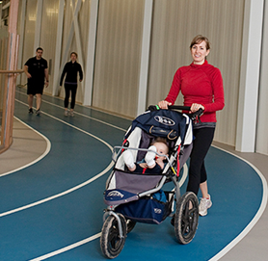
Typical Afternoon
Notes:
The beauty of a Senior Center with a Community Center is that the space can be shared due to the natural flow of the daily schedule. After school, moms and dads with strollers might use the track while the after school crowd will use the other spaces. The schedule challenge will be the holiday weeks where youth and seniors may be on site at the same time. Typically, these weeks require coordination and schedule management to make everyone happy.

Slide 16
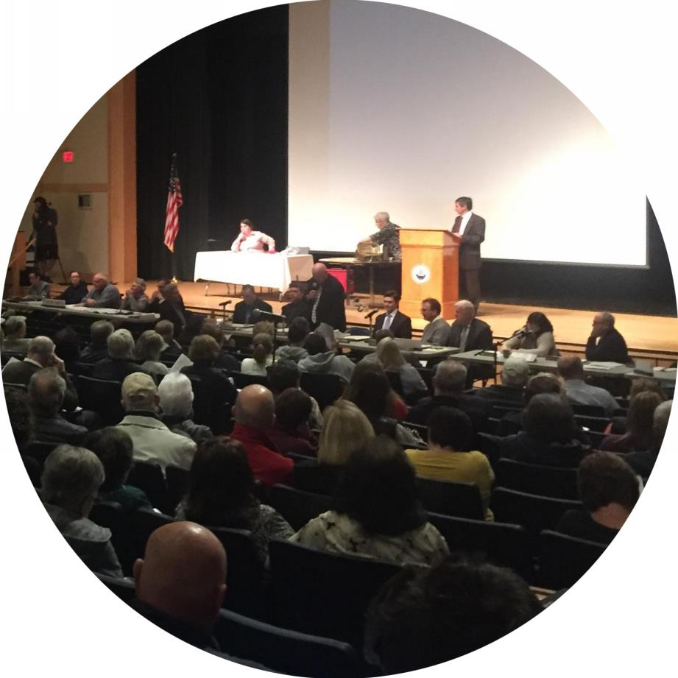
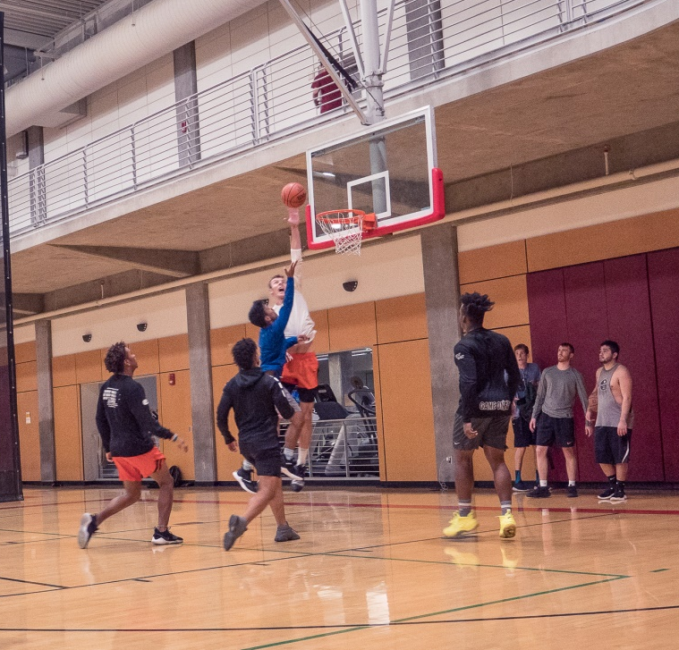
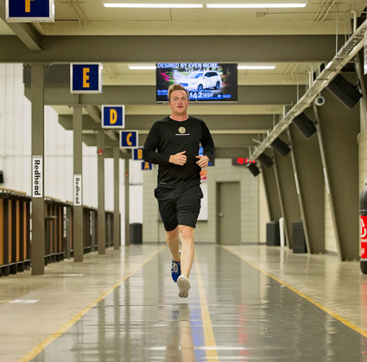
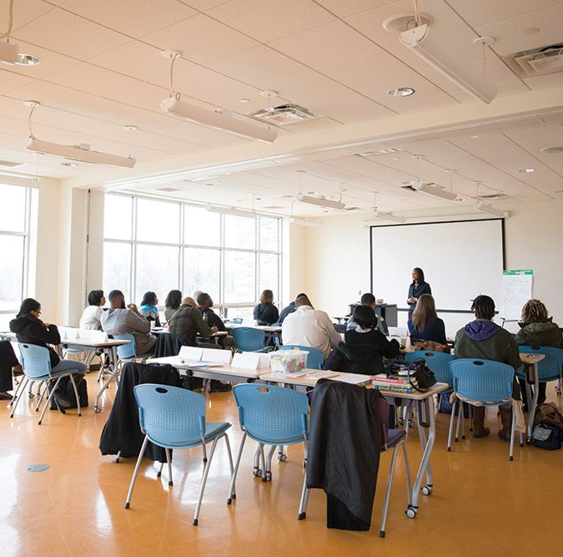
Typical Evening
Notes:
Adults will primarily use the Community Center in the evening for sports, activities and educational purposes. Town meetings may use the various program rooms. The track is open for adult use, the after work crowd.

Slide 17
What Have We Done Since the Last Meeting?
Historic District Commission Meeting
Chamber of Commerce Meeting
Council on Aging Meeting
Traffic & Parking Analysis
Cost Estimate Preparation
Potential Savings Analysis
Operational Plan in Progress

Slide 18
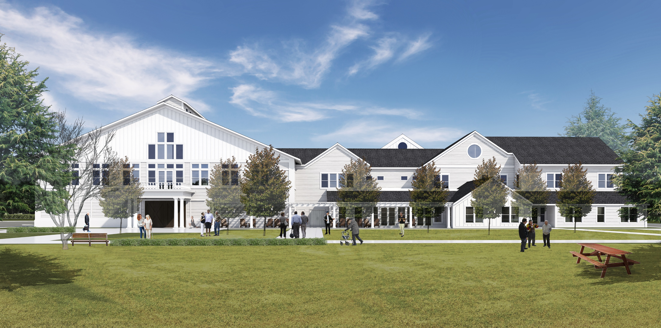
Site Diagram
Perspective Looking Back from the New Town Green Space
Notes:
The concept for the community center is to use these materials and the idea of an assembly of smaller buildings to make the building compatible with the Historic District. The large barn door opening the gym to the Town Green is on the left.

Slide 19
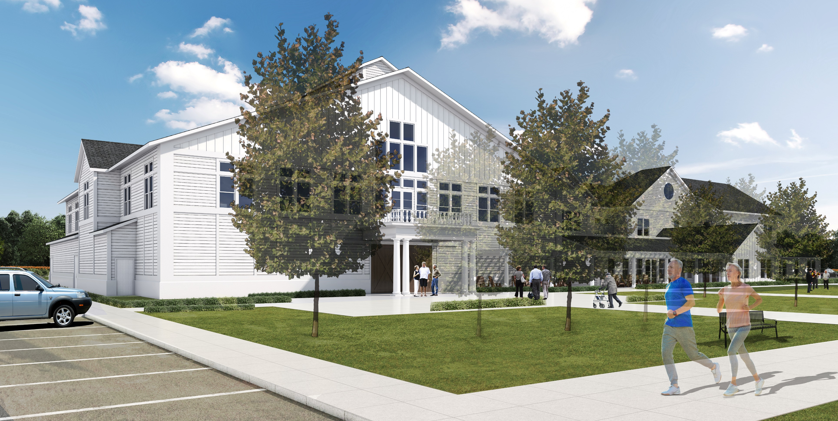
Site Diagram
Perspective Looking Back from the Bandstand

Slide 20
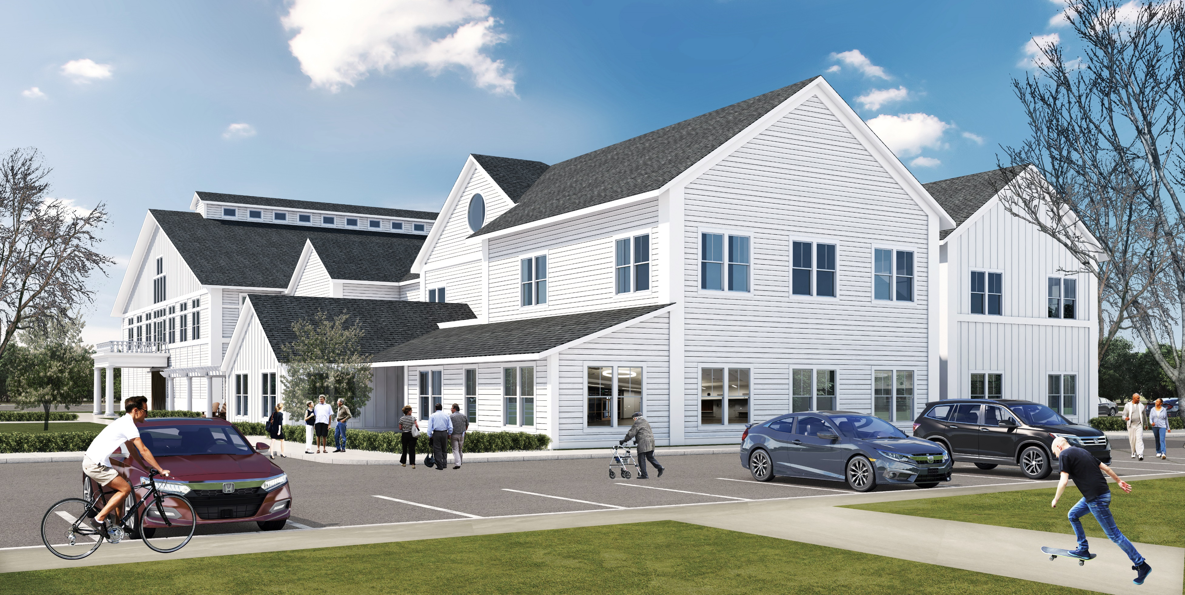
Site Diagram
Perspective Looking Northeast from Library

Slide 21
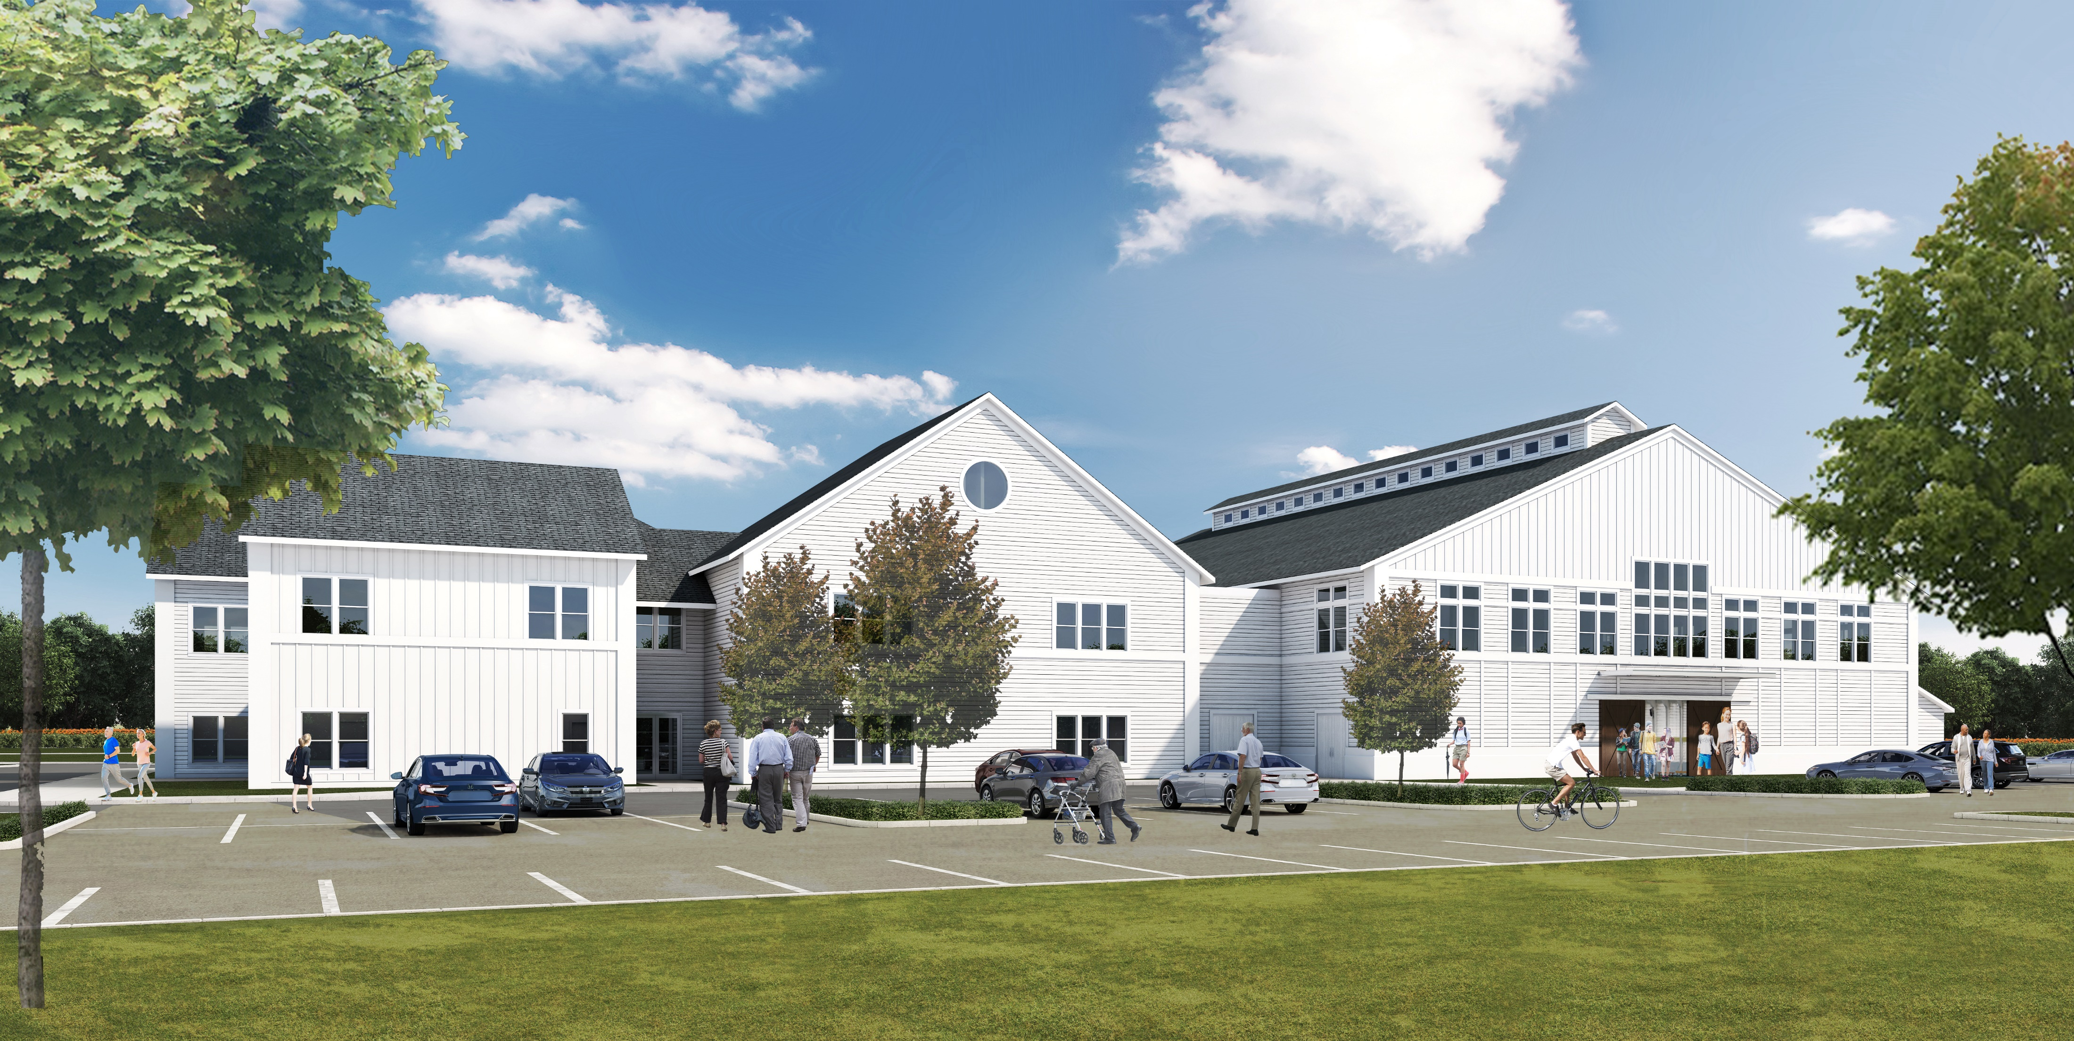
Site Diagram
Perspective Looking East from Parking

Slide 22
Project Cost

Slide 23
Timeline
Spring Town Meeting April
Fiscal Year Begins July 1, 2020
Final Design September 2020
Bid Documents December 2020
Bidding & Awards January & February 2021
Construction April 2021 – June 2022

